Slide 1
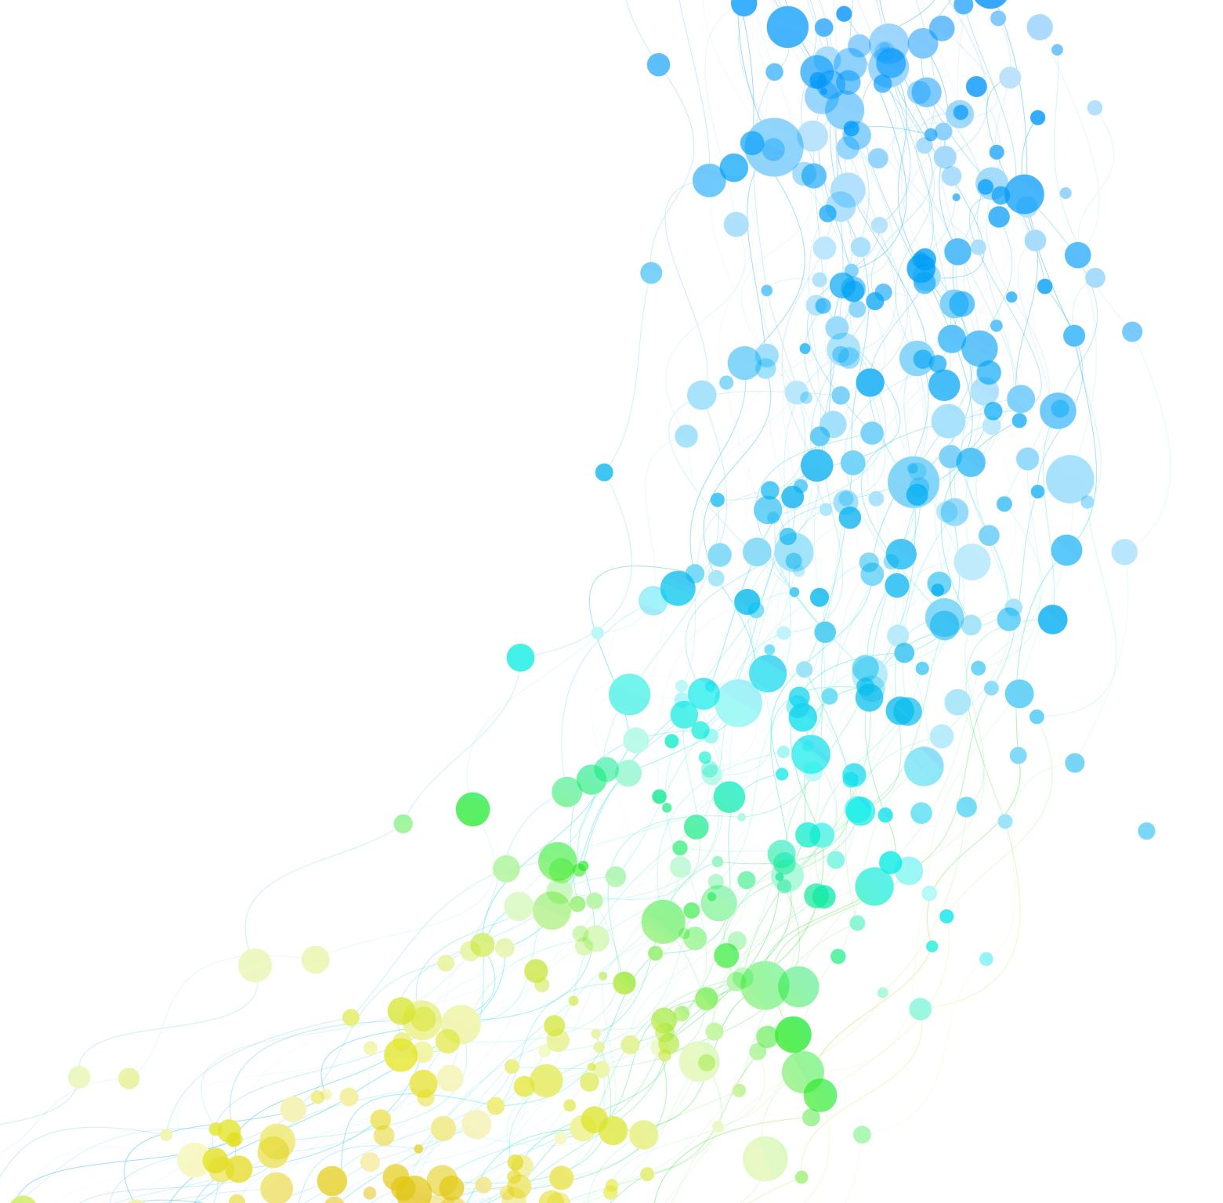
Sheet 3 : Game Playing
Eng. Abdulrahman elmadkhoum

Slide 2
1- Min Max Algorithm
The Minimax algorithm is a decision-making technique commonly used in game theory, specifically for two-player games like chess or tic-tac-toe.
It involves a tree structure that represents all possible moves.

Slide 3
1- Min Max Algorithm
In Minimax, one player is designated the "maximizer" aiming to get the highest possible score, while the other is the "minimizer," who seeks to lower the maximizer's score.
The algorithm recursively explores possible game states down the tree, evaluating each position's score and backtracking to determine the optimal move. Minimax assumes both players are making the best possible moves.

Slide 4
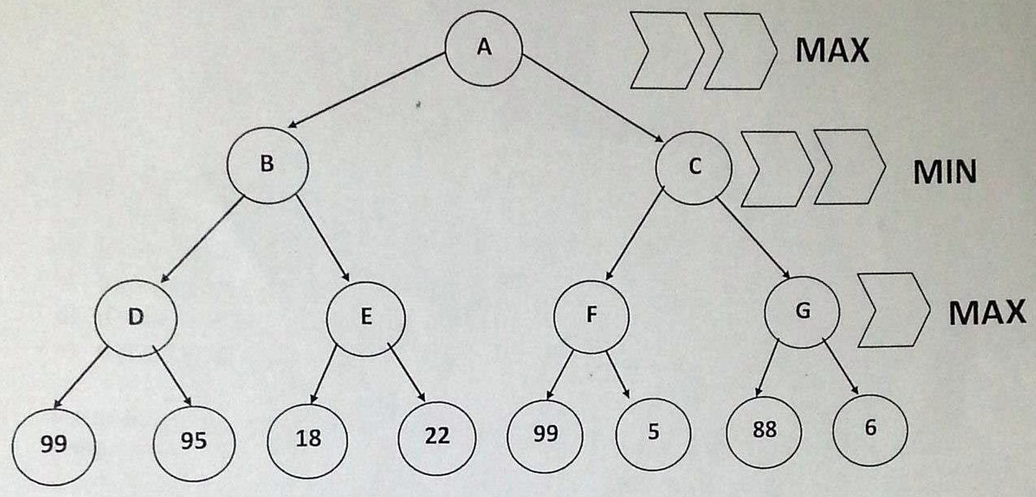
Example : Get the Value of A after applying min max algorithm

Slide 6
It is max player’s turn so he will try to choose the highest score possible
99
22
99
88

Slide 7
Now it ‘s Min player’s turn so he will try to minimize Max’s Score
22
88
99
22
99
88

Slide 8
So This is the Optimal path for A to get the highest gain assuming that both players are playing optimally
88
22
88
99
22
99
88

Slide 9
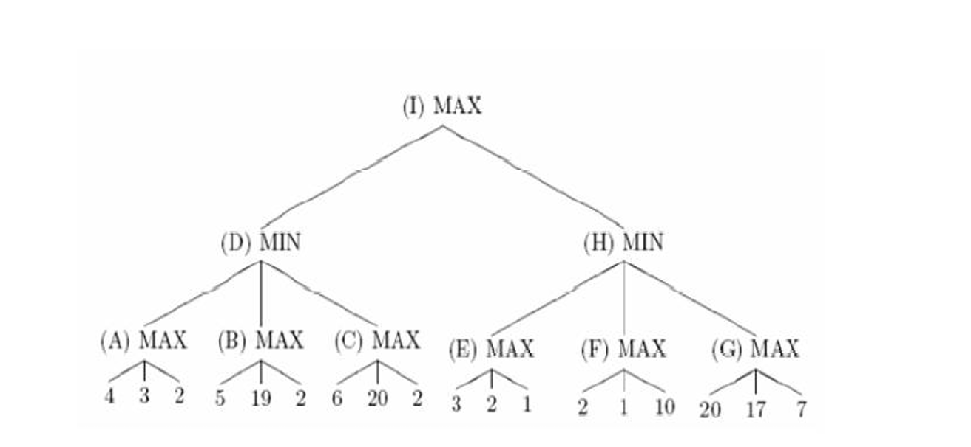
Example : Get the Value of I after applying min max algorithm

Slide 11
4
19
20
3
10
20

Slide 12
4
3
4
19
20
3
10
20

Slide 13
4
4
3
4
19
20
3
10
20

Slide 14
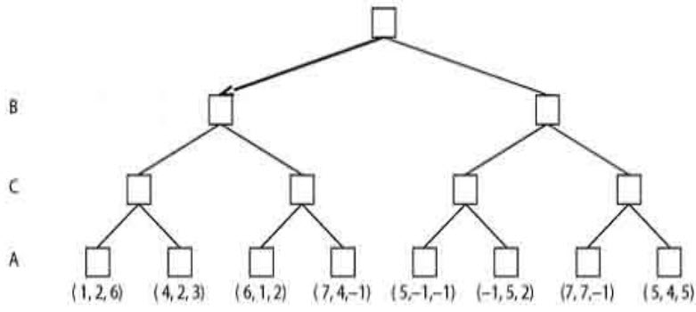
Solve the following 3 players game tree

Slide 16
(4,2,3)
(7,4,-1)
(5,-1,-1)
(7,7,-1)

Slide 17
In this case both C players in each time Has the same score
(4,2,3)
(4,2,3)
(7,4,-1)
(5,-1,-1)
(7,7,-1)

Slide 18
In this case both C players in each time Has the same score
(4,2,3)
Conflict resolution
5+-1 7+7
4 14
(4,2,3)
(7,4,-1)
(5,-1,-1)
(7,7,-1)

Slide 19
(4,2,3)
(5,-1,-1)
(4,2,3)
(7,4,-1)
(5,-1,-1)
(7,7,-1)

Slide 20
(4,2,3)
(4,2,3)
(5,-1,-1)
(4,2,3)
(7,4,-1)
(5,-1,-1)
(7,7,-1)

Slide 21
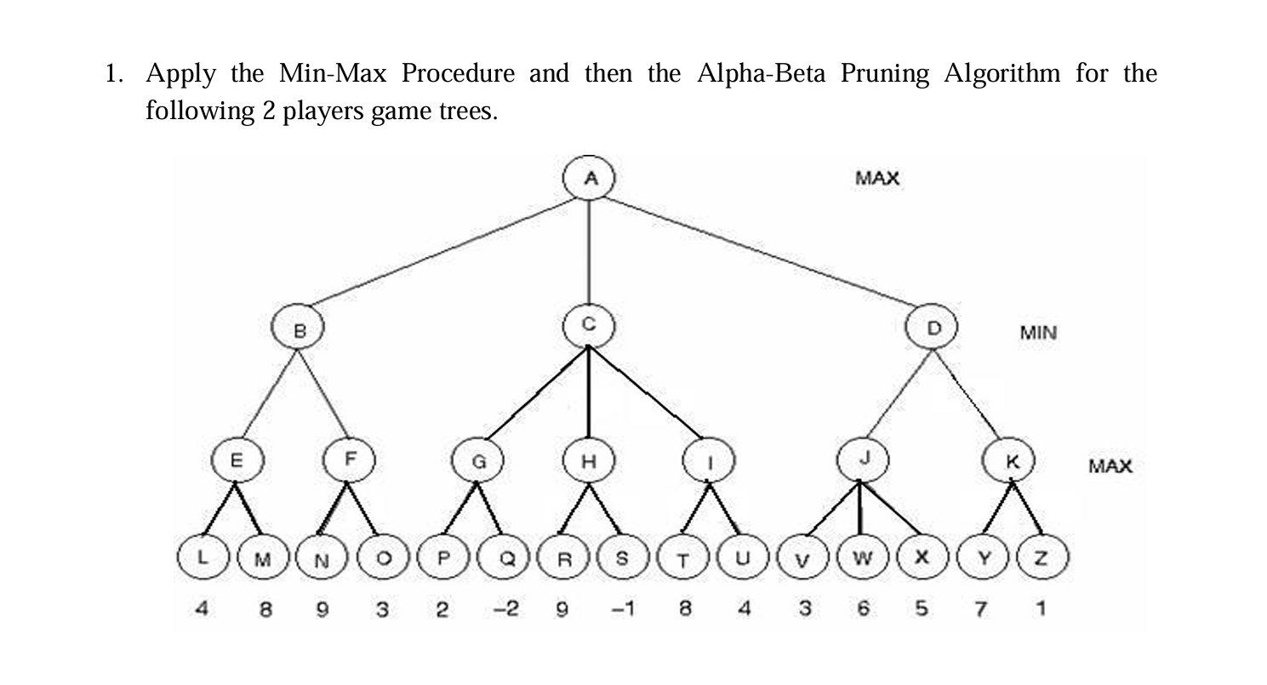
First : Min Max

Slide 22

8
9
2
9
8
6
7

Slide 23
8
2
6
8
9
2
9
8
6
7

Slide 24
8
8
2
6
8
9
2
9
8
6
7

Slide 25
2- Alpha Beta Algorithm
Alpha-Beta Pruning is an optimization technique for the Minimax algorithm that significantly reduces the number of nodes evaluated in the game tree.
It introduces two values, alpha (the best value the maximizer can guarantee) and beta (the best value the minimizer can guarantee).

Slide 26
2- Alpha Beta Algorithm
As the algorithm explores the tree, it "prunes" or cuts off branches that cannot affect the final decision, saving computational resources by skipping over irrelevant moves.
If a node’s score exceeds the current alpha or beta values, further examination of that path stops since it won’t influence the optimal choice. This technique makes the search process more efficient without compromising the outcome.

Slide 27
α = -∞
When to cut ?
α >= β
β <= α
Alpha Beta
β = ∞
β = ∞
β = ∞
α = -∞
α = -∞
α = -∞
α = -∞
α = -∞
α = -∞
α = -∞

Slide 28
α = -∞
When to cut ?
α >= β
β <= α
β = ∞
β = ∞
β = ∞
α = 4
α = -∞
α = -∞
α = -∞
α = -∞
α = -∞
α = -∞

Slide 29
α = -∞
When to cut ?
α >= β
β <= α
β = ∞
β = ∞
β = ∞
α = 8
α = -∞
α = -∞
α = -∞
α = -∞
α = -∞
α = -∞

Slide 30
α = -∞
When to cut ?
α >= β
β <= α
β = 8
β = ∞
β = ∞
α = 8
α = -∞
α = -∞
α = -∞
α = -∞
α = -∞
α = -∞

Slide 31
α = -∞
When to cut ?
α >= β
β <= α
β = 8
β = ∞
β = ∞
α = 8
α = 9
α = -∞
α = -∞
α = -∞
α = -∞
α = -∞

Slide 32
α = -∞
When to cut ?
α >= β
β <= α
Each Time after updating we look up there is a beta value of 8
And alpha is 9
α >= β
9>=8 hence pruning
β = 8
β = ∞
β = ∞
α = 8
α = 9
α = -∞
α = -∞
α = -∞
α = -∞
α = -∞

Slide 33
When to cut ?
α >= β
β <= α
α = 8
β = 8
β = ∞
β = ∞
α = 8
α = 9
α = -∞
α = -∞
α = -∞
α = -∞
α = -∞

Slide 34
When to cut ?
α >= β
β <= α
α = 8
β = 8
β = ∞
β = ∞
α = 8
α = 9
α = 2
α = -∞
α = -∞
α = -∞
α = -∞

Slide 35
When to cut ?
α >= β
β <= α
α = 8
β = 8
β = ∞
β = ∞
α = 8
α = 9
α = 2
α = -∞
α = -∞
α = -∞
α = -∞

Slide 36
When to cut ?
α >= β
β <= α
β <= α
2 <= 8
α = 8
β = 8
β = 2
β = ∞
α = 8
α = 9
α = 2
α = -∞
α = -∞
α = -∞
α = -∞

Slide 37
When to cut ?
α >= β
β <= α
β <= α
2 <= 8
α = 8
β = 8
β = 2
β = ∞
α = 8
α = 9
α = 2
α = -∞
α = -∞
α = -∞
α = -∞

Slide 38
When to cut ?
α >= β
β <= α
α = 8
β = 8
β = 2
β = ∞
α = 8
α = 9
α = 2
α = 3
α = -∞
α = -∞
α = -∞

Slide 39
When to cut ?
α >= β
β <= α
α = 8
β = 8
β = 2
β = ∞
α = 8
α = 9
α = 2
α = 6
α = -∞
α = -∞
α = -∞

Slide 40
When to cut ?
α >= β
β <= α
α = 8
β = 8
β = 2
β = ∞
α = 8
α = 9
α = 2
α = 6
α = -∞
α = -∞
α = -∞

Slide 41
When to cut ?
α >= β
β <= α
β <= α
6 <= 8
α = 8
β = 8
β = 2
β = 6
α = 8
α = 9
α = 2
α = 6
α = -∞
α = -∞
α = -∞

Slide 42
When to cut ?
α >= β
β <= α
β <= α
6 <= 8
α = 8
β = 8
β = 2
β = 6
α = 8
α = 9
α = 2
α = 6
α = -∞
α = -∞
α = -∞

Slide 43
Example : Get the Value of I after applying alpha beta algorithm

Slide 44
When to cut ?
α >= β
β <= α
α = -∞
β = ∞
β = ∞
α = -∞
α = -∞
α = -∞
α = -∞
α = -∞
α = -∞

Slide 45
When to cut ?
α >= β
β <= α
α = -∞
β = ∞
β = ∞
α = 4
α = -∞
α = -∞
α = -∞
α = -∞
α = -∞

Slide 46
When to cut ?
α >= β
β <= α
α = -∞
β = ∞
β = ∞
α = 4
α = -∞
α = -∞
α = -∞
α = -∞
α = -∞

Slide 47
When to cut ?
α >= β
β <= α
α = -∞
β = ∞
β = ∞
α = 4
α = -∞
α = -∞
α = -∞
α = -∞
α = -∞

Slide 48
When to cut ?
α >= β
β <= α
α = -∞
β = 4
β = ∞
α = 4
α = -∞
α = -∞
α = -∞
α = -∞
α = -∞

Slide 49
When to cut ?
α >= β
β <= α
α >= β
5 >= 4
α = -∞
β = 4
β = ∞
α = 4
α = 5
α = -∞
α = -∞
α = -∞
α = -∞

Slide 50
When to cut ?
α >= β
β <= α
α >= β
5 >= 4
α = -∞
β = 4
β = ∞
α = 4
α = 5
α = -∞
α = -∞
α = -∞
α = -∞

Slide 51
When to cut ?
α >= β
β <= α
α >= β
6 >= 4
α = -∞
β = 4
β = ∞
α = 4
α = 5
α = 6
α = -∞
α = -∞
α = -∞

Slide 52
When to cut ?
α >= β
β <= α
α >= β
6 >= 4
α = -∞
β = 4
β = ∞
α = 4
α = 5
α = 6
α = -∞
α = -∞
α = -∞

Slide 53
When to cut ?
α >= β
β <= α
α = 4
β = 4
β = ∞
α = 4
α = 5
α = 6
α = 3
α = -∞
α = -∞

Slide 54
When to cut ?
α >= β
β <= α
α = 4
β = 4
β = ∞
α = 4
α = 5
α = 6
α = 3
α = -∞
α = -∞

Slide 55
When to cut ?
α >= β
β <= α
α = 4
β = 4
β = ∞
α = 4
α = 5
α = 6
α = 3
α = -∞
α = -∞

Slide 56
When to cut ?
α >= β
β <= α
α = 4
β = 4
β = ∞
α = 4
α = 5
α = 6
α = 3
α = -∞
α = -∞

Slide 57
When to cut ?
α >= β
β <= α
β <= α
3 <= 4
α = 4
β = 4
β = 3
α = 4
α = 5
α = 6
α = 3
α = -∞
α = -∞

Slide 58
When to cut ?
α >= β
β <= α
β <= α
3 <= 4
α = 4
β = 4
β = 3
α = 4
α = 5
α = 6
α = 3
α = -∞
α = -∞

Slide 59
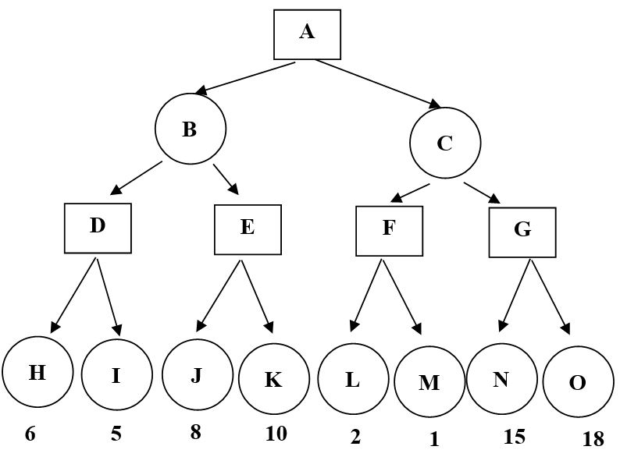
More Examples
max
min
max

Slide 60
6
1- using Min max
max
2
6
min
6
18
10
2
max

Slide 61
α = -∞
2- using alpha beta
max
β = ∞
β = ∞
min
α = -∞
α = -∞
α = -∞
α = -∞
max

Slide 62
α = -∞
2- using alpha beta
max
β = 6
β = ∞
min
α = 6
α = -∞
α = -∞
α = -∞
max

Slide 63
α = -∞
2- using alpha beta
max
β = 6
β = ∞
8 >=6
min
α = 6
α = 8
α = -∞
α = -∞
max

Slide 64
α = 6
2- using alpha beta
max
β = 6
β = ∞
min
α = 6
α = 8
α = -∞
α = -∞
max

Slide 65
α = 6
2 <= 6
2- using alpha beta
max
β = 6
β = 2
min
α = 6
α = 8
α = 2
α = -∞
max

Slide 66
1- min max
10
Max
10
2
Min
10
14
2
20
Max
10
9
14
13
2
1
3
20
Min
Max
10
11
9
12
14
15
13
14
5
2
4
1
3
22
20
21

Slide 67
2- using alpha beta
α = -∞
Max
β = ∞
β = ∞
Min
α = -∞
α = -∞
α = -∞
α = -∞
Max
β = ∞
β = ∞
β = ∞
β = ∞
β = ∞
β = ∞
β = ∞
β = ∞
Min
Max
10
11
9
12
14
15
13
14
5
2
4
1
3
22
20
21

Slide 68
α = -∞
Max
β = ∞
β = ∞
Min
α = 10
α = -∞
α = -∞
α = -∞
Max
β = 10
β = ∞
β = ∞
β = ∞
β = ∞
β = ∞
β = ∞
β = ∞
Min
Max
10
11
9
12
14
15
13
14
5
2
4
1
3
22
20
21

Slide 69
α = -∞
Max
β = ∞
β = ∞
Min
α = 10
α = -∞
α = -∞
α = -∞
Max
β = 10
β = 9
β = ∞
β = ∞
β = ∞
β = ∞
β = ∞
β = ∞
Min
Max
10
11
9
12
14
15
13
14
5
2
4
1
3
22
20
21

Slide 70
α = -∞
Max
β = ∞
β = ∞
Min
α = 10
α = -∞
α = -∞
α = -∞
Max
β = 10
β = 9
β = ∞
β = ∞
β = ∞
β = ∞
β = ∞
β = ∞
Min
Max
10
11
9
12
14
15
13
14
5
2
4
1
3
22
20
21

Slide 71
α = -∞
Max
β = 10
β = ∞
Min
α = 10
α = -∞
α = -∞
α = -∞
Max
β = 10
β = 9
β = ∞
β = ∞
β = ∞
β = ∞
β = ∞
β = ∞
Min
Max
10
11
9
12
14
15
13
14
5
2
4
1
3
22
20
21

Slide 72
α = -∞
Max
β = 10
β = ∞
Min
α = 10
α = -∞
α = -∞
α = -∞
Max
β = 10
β = 9
β = 14
β = ∞
β = ∞
β = ∞
β = ∞
β = ∞
Min
Max
10
11
9
12
14
15
13
14
5
2
4
1
3
22
20
21

Slide 73
α = -∞
Max
β = 10
β = ∞
Min
α = 10
α = 14
α = -∞
α = -∞
Max
β = 10
β = 9
β = 14
β = ∞
β = ∞
β = ∞
β = ∞
β = ∞
Min
Max
10
11
9
12
14
15
13
14
5
2
4
1
3
22
20
21

Slide 74
α = -∞
Max
β = 10
β = ∞
Min
α = 10
α = 14
α = -∞
α = -∞
Max
β = 10
β = 9
β = 14
β = ∞
β = ∞
β = ∞
β = ∞
β = ∞
Min
Max
10
11
9
12
14
15
13
14
5
2
4
1
3
22
20
21

Slide 75
α = 10
Max
β = 10
β = ∞
Min
α = 10
α = 14
α = -∞
α = -∞
Max
β = 10
β = 9
β = 14
β = ∞
β = ∞
β = ∞
β = ∞
β = ∞
Min
Max
10
11
9
12
14
15
13
14
5
2
4
1
3
22
20
21

Slide 76
α = 10
Max
β = 10
β = ∞
Min
α = 10
α = 14
α = -∞
α = -∞
Max
β = 10
β = 9
β = 14
β = ∞
β = 5
β = ∞
β = ∞
β = ∞
Min
Max
10
11
9
12
14
15
13
14
5
2
4
1
3
22
20
21

Slide 77
α = 10
Max
β = 10
β = ∞
Min
α = 10
α = 14
α = -∞
α = -∞
Max
β = 10
β = 9
β = 14
β = ∞
β = 5
β = ∞
β = ∞
β = ∞
Min
Max
10
11
9
12
14
15
13
14
5
2
4
1
3
22
20
21

Slide 78
α = 10
Max
β = 10
β = ∞
Min
α = 10
α = 14
α = 5
α = -∞
Max
β = 10
β = 9
β = 14
β = ∞
β = 5
β = 4
β = ∞
β = ∞
Min
Max
10
11
9
12
14
15
13
14
5
2
4
1
3
22
20
21

Slide 79
α = 10
Max
β = 10
β = ∞
Min
α = 10
α = 14
α = 5
α = -∞
Max
β = 10
β = 9
β = 14
β = ∞
β = 5
β = 4
β = ∞
β = ∞
Min
Max
10
11
9
12
14
15
13
14
5
2
4
1
3
22
20
21

Slide 80
α = 10
Max
β = 10
β = 5
Min
α = 10
α = 14
α = 5
α = -∞
Max
β = 10
β = 9
β = 14
β = ∞
β = 5
β = 4
β = ∞
β = ∞
Min
Max
10
11
9
12
14
15
13
14
5
2
4
1
3
22
20
21

Slide 81
α = 10
Max
β = 10
β = 5
Min
α = 10
α = 14
α = 5
α = -∞
Max
β = 10
β = 9
β = 14
β = ∞
β = 5
β = 4
β = ∞
β = ∞
Min
Max
10
11
9
12
14
15
13
14
5
2
4
1
3
22
20
21

